Slide 1

Presentation on
Fake NEWS DETECTION USING NATURAL LANGUAGE PROCESSING
of
Bachelor Of Technology
in
Computer Science and Engineering(Data Science)
By
Moguloju Sai
College: TKR College of Engineering and Technology

Slide 2
PROBLEM STATEMENT
I'm embarking on a project where I'll leverage a CSV dataset containing four columns to develop a sophisticated machine learning model. This model will be designed to effectively classify news articles as either authentic or fabricated. By harnessing the power of data and machine learning algorithms,
My aim is to create a robust tool that can accurately discern between real and fake news, thereby contributing to the fight against misinformation.

Slide 3
ABSTRACT
Fake news is false or deceptive information presented as legitimate news, often spread due to human behavior such as attraction to novelty and sensationalism, as well as motivated reasoning prompting individuals to share deceptive content.
This study introduces a machine learning framework aimed at identifying fake news, leveraging natural language processing and four distinct machine learning algorithms: logistic regression, decision tree, random forest, and gradient boosting classifier.
The framework utilizes a substantial dataset containing both genuine and fabricated news stories to construct a classification model, allowing for the assessment of its performance in distinguishing between real and fake news.
Results demonstrate the superior performance of the machine learning framework compared to existing systems, highlighting the potential of natural language processing and machine learning methodologies in effectively detecting fake news.

Slide 4
INTRODUCTION
The study aims to combat the proliferation of fake news by leveraging machine learning and natural language processing techniques to identify deceptive or incorrect information, particularly from unreliable sources.
Fake news is perpetuated through biased software and thrives on internet and social media platforms, contributing to a distorted user experience and intensifying the challenge of distinguishing reality from falsehood.
Common sources of fake news include satire websites, known for publishing exaggerated news parodies for entertainment purposes, and click-bait platforms like Buzzfeed and Upworthy, which craft sensationalist headlines to attract readerships.
The dataset for this study comprises both genuine and fabricated news articles, obtained from Kaggle, and undergoes preprocessing and feature extraction using the NLTK package to prepare it for analysis.
Various machine learning algorithms, including Logistic Regression, Decision Tree Classifier, Gradient Boosting Classifier, and Random Forest Classifier, are employed to classify the news articles and distinguish between genuine and fake content.

Slide 5
OBJECTIVE
The objective of this project is to combat the proliferation of fake news by implementing data-driven strategies for detection. This entails compiling datasets containing various features such as article content, source credibility, publication history, and social media engagement.
Through exploratory data analysis (EDA) and feature engineering, we aim to refine data quality and glean insights into the characteristics of fake news. Machine learning models and natural language processing, including classification algorithms, will be developed to accurately identify instances of misinformation.
The emphasis lies in interpreting model outputs to understand the underlying factors contributing to the dissemination of fake news, facilitating targeted interventions. Ethical and regulatory considerations will be paramount throughout the project.
Project findings will be documented in comprehensive reports for stakeholders, aiming to combat misinformation and promote information integrity through data-driven decision-making.

Slide 6
EXISTING SYSTEM
The current landscape of fake news detection relies heavily on conventional methods, with misinformation scattered across various sources or represented in disparate formats.
This fragmented approach leads to inefficiencies in identifying and addressing fake news, hindering effective management of information integrity.
Decisions regarding the authenticity of news articles are often made manually, lacking the utilization of advanced data analytics or predictive modeling techniques. Consequently, the detection system struggles to distinguish between genuine and fabricated news, resulting in the proliferation of misinformation and its adverse impacts on society

Slide 7
LITERATURE SURVEY
Title: "A Survey on Natural Language Processing for Fake News Detection"
Author: Ray Oshikawa, Jing Qian, William Yang Wang
Publish Year: 2020
Description: This paper the increasing challenge of fake news detection in the realm of Natural Language Processing (NLP), emphasizing its criticality due to the proliferation of social media platforms. It reviews existing approaches, datasets, and limitations, and proposes avenues for future research to enhance the accuracy and practicality of fake news detection models. It underscores the necessity of NLP solutions in mitigating the spread of misinformation online.

Slide 8
Title: "Fake News Detection via NLP is Vulnerable to Adversarial Attacks"
Author: Zhixuan Zhou, Huankang Guan, Meghana Moorthy Bhat, Justin Hsu
Publish Year: 2019
Description: It is discussed the rise of fake news and the limitations of existing detection methods, emphasizing the potential for misclassification. It proposes combining fact checking with linguistic analysis and suggests a crowdsourced knowledge graph as a solution for collecting timely facts about news events.
Title: "Fake News Detection Using Machine Learning Approaches"
Author: Z Khanam, B N Alwasel, H Sirafi and M Rashid
Publish Year: 2020
Description: This research paper focused on analyzing methods for detecting fake news, proposing the use of traditional machine learning models and Python libraries like scikit-learn and NLP for feature extraction and classification. The paper aims to develop a supervised learning algorithm capable of accurately classifying news articles as true or false using textual analysis.

Slide 9
Title: "Fake News Detection using Deep Learning"
Author: Sheng How Kong, Li Mei Tan, Keng Hoon Gan, Nur Hana Samsudin
Publish Year: 2020
Description: The paper outlines a study focusing on combating the spread of fake news by employing natural language processing (NLP) techniques and deep learning models to detect misleading stories. It highlights the use of TensorFlow and Keras libraries for model development, emphasizing better performance with news content compared to news titles, and slightly superior results with N-gram vectors.
Title: " A Comprehensive Review on Fake News Detection With Deep Learning"
Author: M. F. Mridha; Ashfia Jannat Keya; Md. Abdul Hamid; Muhammad Mostafa Monowar; Md. Saifur Rahman
Publish Year: 2021
Description: The paper discussed the challenge of detecting online fake news and highlights the effectiveness of deep learning techniques compared to traditional methods. It explores advanced deep learning approaches like Attention and GANs, offering recommendations for future research to enhance fake news detection mechanisms.

Slide 10
LITERATURE SURVEY CONCLUSION
Firstly, algorithmic accuracy often falls short, resulting in inconsistent outcomes and unreliable predictions.
Secondly, employing identical code for prediction and detection tasks limits the system's ability to effectively differentiate between various tasks, thereby compromising its overall effectiveness.
Thirdly, slow output delivery on web pages leads to user frustration and delays, highlighting a need for optimization in this area.
Moreover, reliance on outdated training data impedes the system's capacity to adapt to evolving trends and patterns, undermining its overall performance.
Lastly, despite advancements, machine learning techniques still struggle with accurately discerning fake news from real news, posing the risk of misclassification errors and further challenging the reliability of automated systems in this domain.

Slide 11
PROPOSED SYSTEM
In our proposed project, we employ cutting-edge technologies to predict the authenticity of news articles.
The proposed system for fake news detection involves gathering and preprocessing a diverse array of true and fake news data, employing NLTK package for stemming, constructing Random Forest Classifier and Logistic Regression models with scikit-learn, serializing the models with Joblib for efficient storage, and developing a user-friendly web application using Streamlit for interactive predictions.
Our system promises swift delivery of highly accurate results.

Slide 12
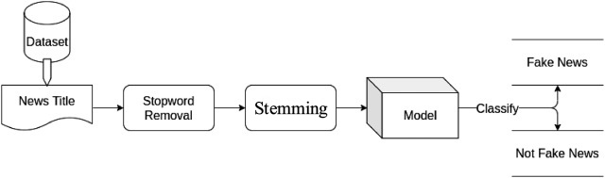
ARCHITECTURE DIAGRAM

Slide 13
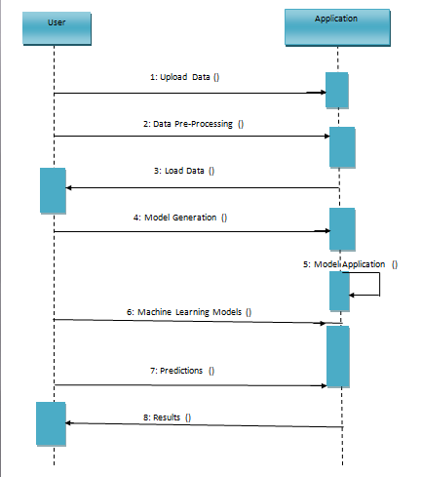
SEQUENCE DIAGRAM

Slide 14
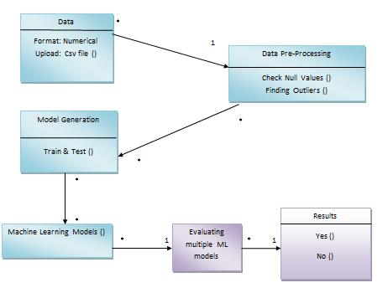
USE CASE DIAGRAM

Slide 15
METHODOLOGY
Understanding the Problem Statement
Data Collection
Data Checks to Perform
Exploratory Data Analysis
Data Preprocessing
Model Training
Choose The Best Model

Slide 16
TECHNOLOGY SPECIFICATIONS
Hardware Specifications:
Processer : Intel i3 or above
Hard disk : 120GB
Ram : 4GB or higher
Software Specifications:
OS : Windows 8 or above
Programming : Python 3.7 or above
Python IDE : Jupiter notebook
Local System : Anaconda installation with necessary libraries installations
Cloud : Google Colab

Slide 17

SNAPSHOTS

Slide 18
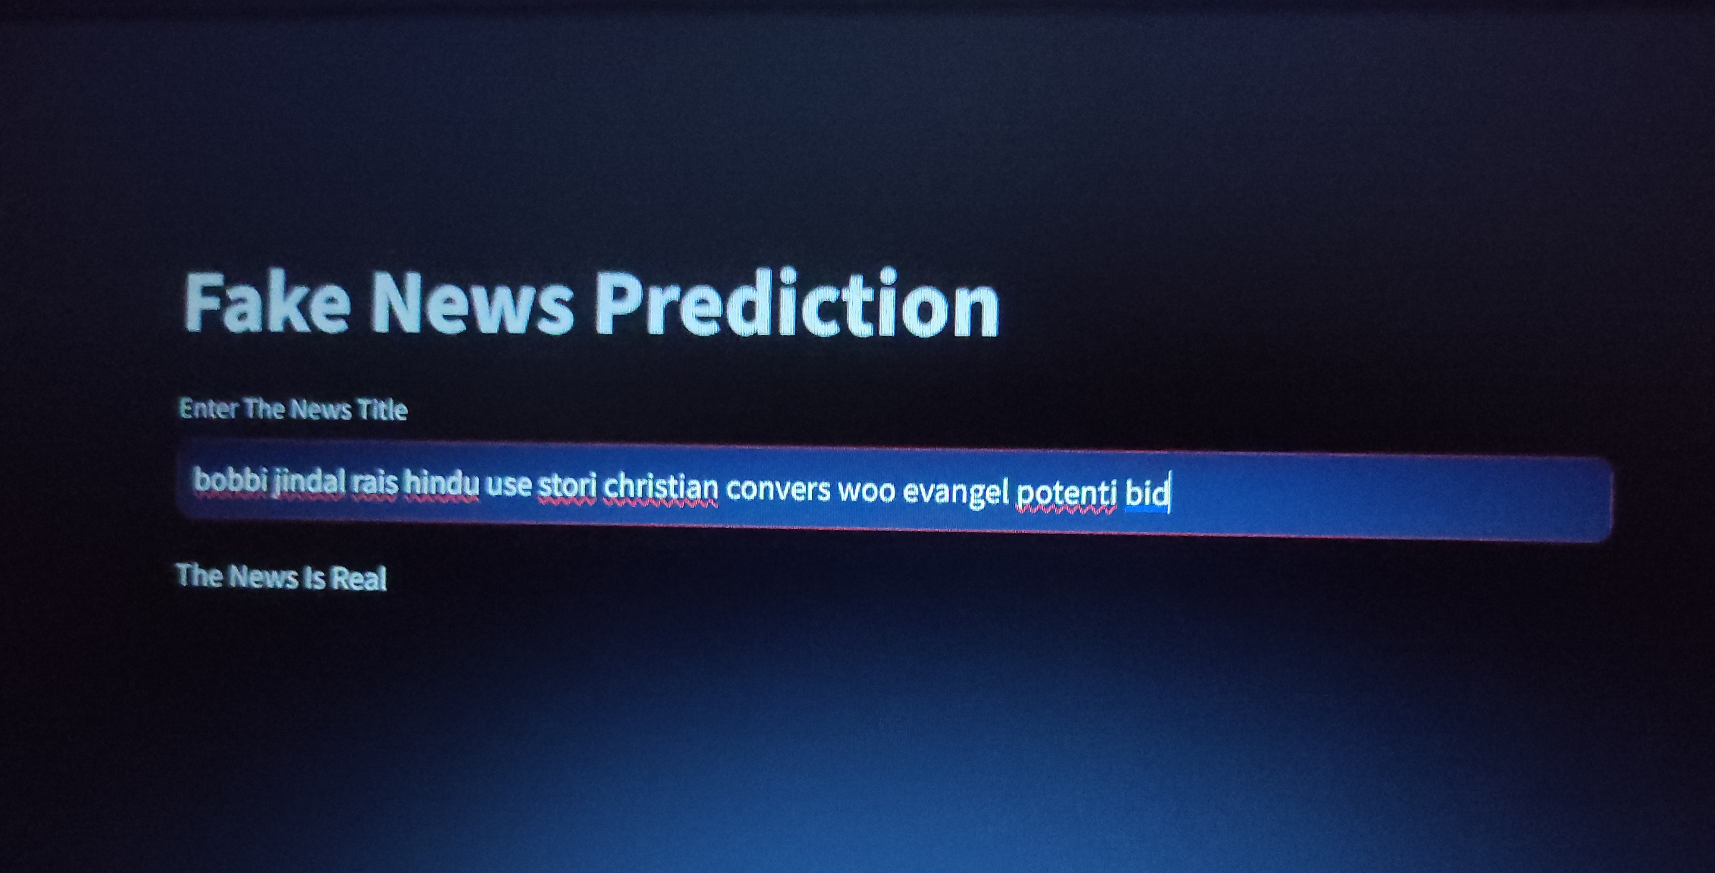

Slide 19
TESTING
Integration Testing: Verify that the deployed model integrates seamlessly with the existing infrastructure, such as databases, APIs, or front-end applications.
Scalability Testing: Assess the performance of the model under varying loads to ensure scalability. This involves testing the model's response time and resource consumption as the number of requests increases.
Model Input Validation: Validate the input data to ensure that it meets the expected format and range. Implement checks to handle missing values, outliers, or unexpected inputs gracefully.
Model Output Verification: Validate the output of the model against expected results or ground truth labels. Compare model predictions with actual outcomes to ensure accuracy.
Error Handling: Implement robust error handling mechanisms to gracefully handle errors and exceptions that may occur during model inference. Provide informative error messages for easier debugging.
Security Testing: Assess the security of the deployed model to identify and mitigate potential vulnerabilities, such as input validation bypasses, injection attacks, or unauthorized access to sensitive data.

Slide 20
FUTURE SCOPE
For future enhancements to a fake news detection project, several avenues can be explored to bolster its efficacy. This includes the integration of advanced machine learning models like neural networks to capture intricate patterns within news content, implementing ensemble methods for enhanced prediction accuracy, and developing real-time data processing capabilities to swiftly identify and counteract misinformation. Dynamic feature engineering techniques can automate the extraction of relevant features, while interactive visualization tools empower users to analyze news data effectively. Strengthened security measures ensure the protection of user privacy, and integration with news monitoring systems enables the incorporation of comprehensive news histories. Continuous monitoring and updates to the model maintain its accuracy over time, while scaling the service expands its reach and impact. Ongoing research and innovation drive the evolution of the project, ensuring its relevance and effectiveness in combating fake news. These enhancements collectively optimize fake news detection strategies and promote the dissemination of accurate information.

Slide 21
CONCLUSION
The implementation of natural language processing and advanced algorithms such as the Random Forest Classifier significantly enhances predictive accuracy in discerning the authenticity of news articles.
The integration of Joblib for model serialization ensures efficient storage, optimizing system performance and scalability, thus enhancing overall efficiency. Streamlit's utilization in web application development significantly enhances user experience, providing an intuitive and interactive interface for seamless interaction.
Centralized data management and automated predictive modeling further contribute to improved efficiency, streamlining the analysis and classification of news articles. Moreover, the system's scalability enables effortless deployment on server or cloud platforms, ensuring widespread accessibility and usability for a larger audience.
These collective advancements in fake news detection using NLP techniques promise a more robust and reliable approach to combatting misinformation and promoting the dissemination of accurate information.

Slide 22
THANK YOU !

